Slide 1
Computer Networks
The Network Layer
TCP/IP
Adrian Sergiu DARABANT
Lecture 8

Slide 2
IP Datagram
IP protocol version
number
32 bits
total datagram
length (bytes)
header length
(bytes)
head.
Len(4)
type of
Service(8)
Ver(4)
Length(8)
13 bit fragment
offset(13)
for
fragmentation/
reassembly
“type” of data
16-bit identifier(16)
Flgs(3)
max number
remaining hops
(decremented at
each router)
time to
Live(8)
upper
layer(8)
Header Internet
checksum(16)
DF+MF
32 bit source IP address(32)
upper layer protocol
to deliver payload to
32 bit destination IP address(32)
Options (if any)
E.g. timestamp,
record route
taken, specify
list of routers
to visit.
how much overhead with TCP?
20 bytes of TCP
20 bytes of IP
= 40 bytes + app layer overhead
data
(variable length,
typically a TCP
or UDP segment)

Slide 3

Datagram: from source to destination
forwarding table in A
Dest. Net. next router Nhops
223.1.1 1
223.1.2 223.1.1.4 2
IP datagram:
223.1.3 223.1.1.4 2
misc
fields
source
IP addr
dest
IP addr
data
A
223.1.1.1
datagram remains unchanged, as it travels source to destination
addr fields of interest here
223.1.2.1
223.1.1.2
223.1.1.4
223.1.2.9
B
223.1.2.2
E
223.1.1.3
223.1.3.27
223.1.3.1
223.1.3.2

Slide 4
Datagram: from source to destination
forwarding table in A
misc
fields
Dest. Net. next router Nhops
223.1.1.1
223.1.1.3
data
223.1.1 1
Starting at A, send IP datagram addressed to B:
look up net. address of B in forwarding table
find B is on same net. as A
link layer will send datagram directly to B inside link-layer frame
  B and A are directly connected
223.1.2 223.1.1.4 2
223.1.3 223.1.1.4 2
A
223.1.1.1
223.1.2.1
223.1.1.2
223.1.1.4
223.1.2.9
B
223.1.2.2
E
223.1.1.3
223.1.3.27
223.1.3.1
223.1.3.2

Slide 5
Datagram: from source to destination
forwarding table in A
misc
fields
Dest. Net. next router Nhops
223.1.1.1
223.1.2.3
data
223.1.1 1
Starting at A, dest. E:
look up network address of E in forwarding table
E on different network
  A, E not directly attached
routing table: next hop router to E is 223.1.1.4
link layer sends datagram to router 223.1.1.4 inside link-layer frame
datagram arrives at 223.1.1.4
continued…..
223.1.2 223.1.1.4 2
223.1.3 223.1.1.4 2
A
223.1.1.1
223.1.2.1
223.1.1.2
223.1.1.4
223.1.2.9
B
223.1.2.2
E
223.1.1.3
223.1.3.27
223.1.3.1
223.1.3.2

Slide 6
Datagram: from source to destination
forwarding table in router
misc
fields
Dest. Net router Nhops interface
223.1.1.1
223.1.2.3
data
223.1.1 - 1 223.1.1.4
Arriving at 223.1.4, destined for 223.1.2.2
look up network address of E in router’s forwarding table
E on same network as router’s interface 223.1.2.9
  router, E directly attached
link layer sends datagram to 223.1.2.2 inside link-layer frame via interface 223.1.2.9
datagram arrives at 223.1.2.2!!! (hooray!)
223.1.2 - 1 223.1.2.9
223.1.3 - 1 223.1.3.27
A
223.1.1.1
223.1.2.1
223.1.1.2
223.1.1.4
223.1.2.9
B
223.1.2.2
E
223.1.1.3
223.1.3.27
223.1.3.1
223.1.3.2

Slide 7
Fragmentation/Reassembly
network links have MTU (max.transfer size) - largest possible link-level frame.
  different link types, different MTUs
large IP datagram divided (“fragmented”) within net
  one datagram becomes several datagrams
  “reassembled” only at final destination
  IP header bits used to identify, order related fragments
fragmentation:
in: one large datagram
out: 3 smaller datagrams
reassembly

Slide 8
Fragmentation/Reassembly
length
=4000
ID
=x
fragflag
=0
offset
=0
Example
4000 byte datagram
MTU = 1500 bytes
One large datagram becomes
several smaller datagrams
length
=1500
ID
=x
fragflag
=1
offset
=0
length
=1500
ID
=x
fragflag
=1
offset
=1480
length
=1040
ID
=x
fragflag
=0
offset
=2960

Slide 9
NAT – Network Address Translation
rest of
Internet
local network
(e.g., home network)
10.0.0/24
10.0.0.1
10.0.0.4
10.0.0.2
138.76.29.7
10.0.0.3
All datagrams leaving local
network have same single source NAT IP address: 138.76.29.7,
different source port numbers
Datagrams with source or
destination in this network
have 10.0.0/24 address for
source, destination (as usual)

Slide 10
NAT – Network Address Translation
Motivation: local network uses just one IP address as far as outside word is concerned:
  no need to be allocated range of addresses from ISP: - just one IP address is used for all devices
  can change addresses of devices in local network without notifying outside world
  can change ISP without changing addresses of devices in local network
  devices inside local net not explicitly addressable, visible by outside world (a security plus).

Slide 11
NAT – Network Address Translation
NAT translation table
WAN side addr LAN side addr
1: host 10.0.0.1
sends datagram to
128.119.40, 80
138.76.29.7, 5001 10.0.0.1, 3345
…… ……
S: 10.0.0.1, 3345
D: 128.119.40.186, 80
10.0.0.1
1
2
S: 138.76.29.7, 5001
D: 128.119.40.186, 80
10.0.0.4
10.0.0.2
138.76.29.7
S: 128.119.40.186, 80
D: 10.0.0.1, 3345
4
S: 128.119.40.186, 80
D: 138.76.29.7, 5001
3
10.0.0.3
4: NAT router
changes datagram
dest addr from
138.76.29.7, 5001 to 10.0.0.1, 3345
3: Reply arrives
dest. address:
138.76.29.7, 5001

Slide 12
NAT – Network Address Translation
16-bit port-number field:
  60,000 simultaneous connections with a single LAN-side address!
NAT is controversial:
  routers should only process up to layer 3
  violates end-to-end argument
    NAT possibility must be taken into account by app designers, e.g., P2P applications
  address shortage should instead be solved by IPv6

Slide 13
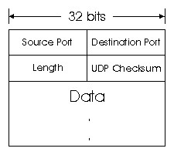
UDP
Checksum – for the entire datagram (header + data)
Length >=8 – entire datagram

Slide 14
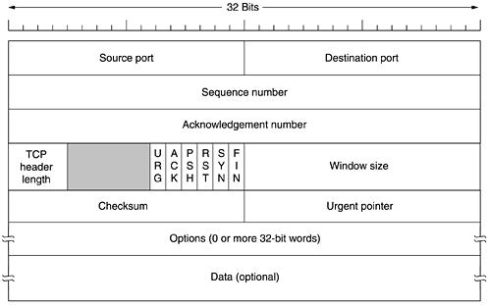
TCP Datagrams

Slide 15
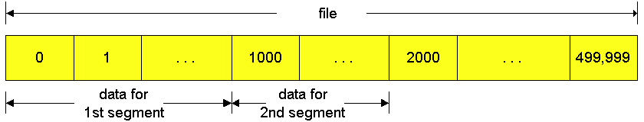
TCP Segments

Slide 16
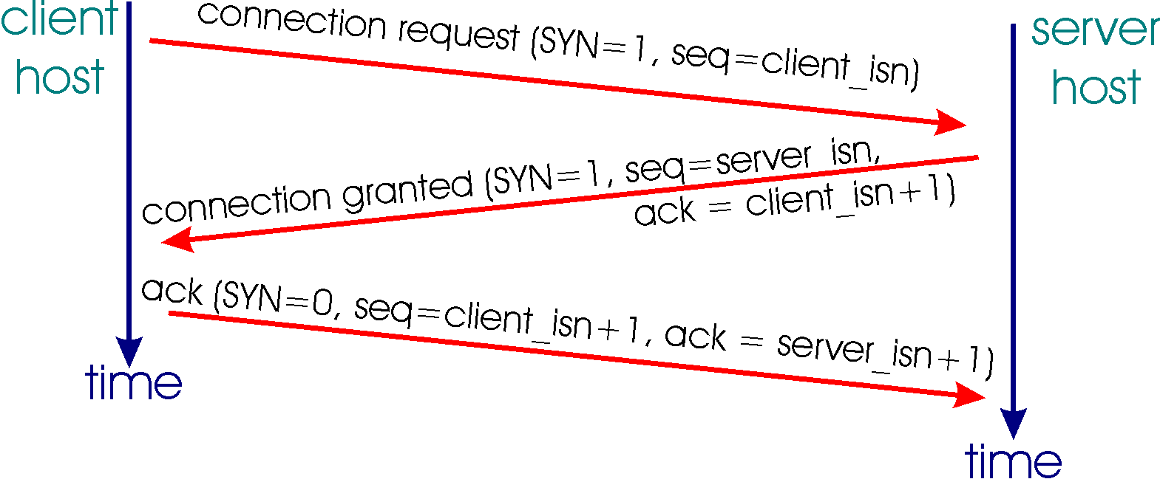
TCP Open

Slide 17
Seq numbers and Acks
Sequence numbers are used to reassemble data in the order in which it was sent.
Sequence numbers increment based on the number of bytes in the TCP data field.
  –Known as a Byte Sequencing Protocol
Each segment transmitted must be acknowledged.
  –Multiple segments can be acknowledged
The ACK (Acknowledgement) field indicates the next byte (sequence) number the receiver expects to receive.
The sender, no matter how many transmitted segments, expects to receive an ACK that is one more than the number of the last transmitted byte.

Slide 18

TCP Client States

Slide 19

TCP Server States

Slide 20
TCP Flow & Window Control
Sliding Window mechanism = the number of allowed unacknowledged bytes
  Stop and Wait
  Go-back N (TCP)
  Selective Repeat
Receiver Window
Sender Window

Slide 21
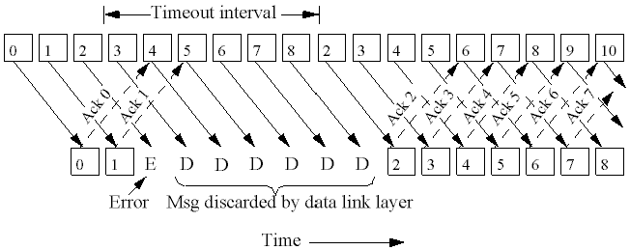
Go Back N
If seg k not received => discard k+1, k+2, etc
This implicitly sets the Window Size =1

Slide 22
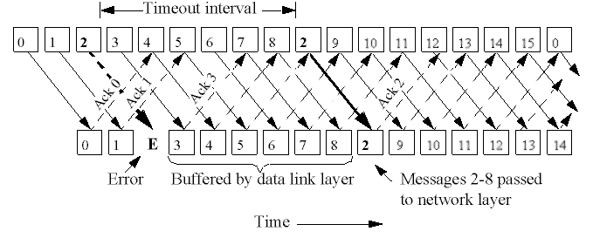
Selective Repeat

Slide 23
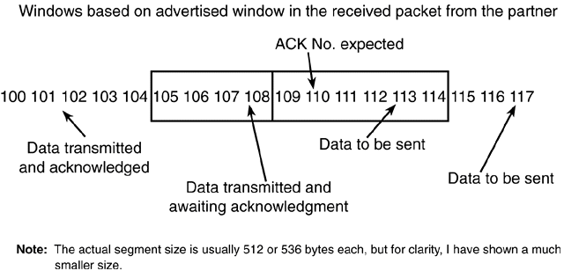
TCP Send Window

Slide 24
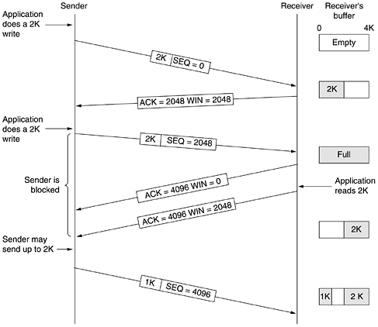
Window Management

Slide 25
TCP Retransmission
TCP will retransmit a segment upon expiration of an adaptive transmission timer.
The timer is variable.
When TCP transmits a segment, it records the time of transmission and the sequence number of the segment.
When TCP receives an acknowledgment, it records the time.
This allows TCP to build a sample round-trip delay time. (RTT)
TCP will build an average delay time for a packet to be sent and received.
The timer is slowly changed to allow for the varying differences in the Internet.

Slide 26
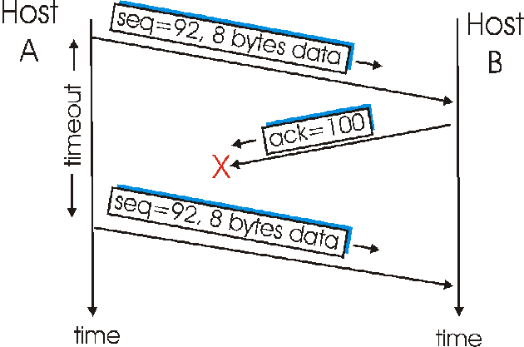
Retransmission-1

Slide 27
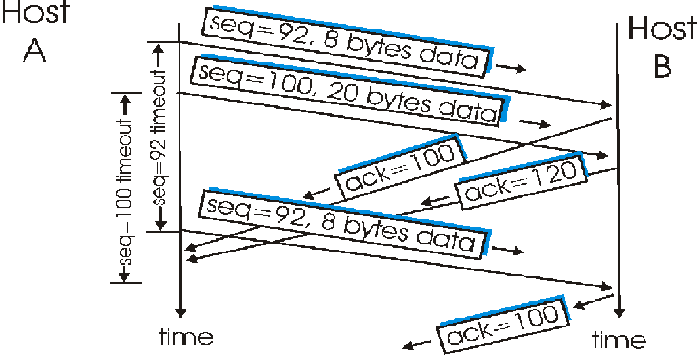
Retransmission-2

Slide 28
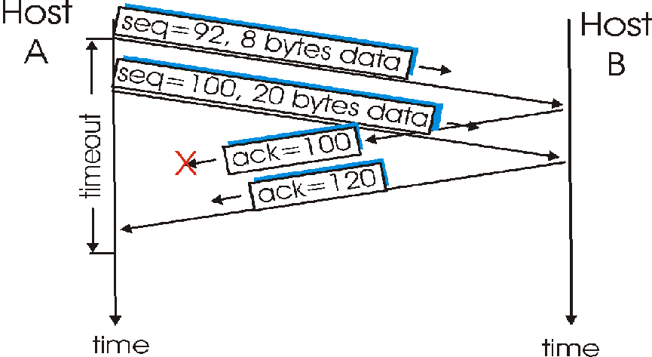
Retransmission-3

Slide 29
Congestion Control
Before this, TCP would start to transmit as much data as was allowed in the advertised window.
A new window was added called the congestion window. –It is not negotiated, it is assumed. It starts out with one segment !

Slide 30
Slow Start
Slow start initializes a congestion window of 1 segment.
Each subsequent ACK increments this window exponentially (1, 2, 4, 8, etc.) eventually to the advertised window size
As long as there are no time-outs or duplicate ACKs during the transmission between two stations, it stays at the advertised window size.
The distinction here is that the congestion window is flow control imposed by the sender, while the Advertised window is flow control imposed by the receiver.

Slide 31
Congestion
Upon congestion (duplicate ACKs or time-out), the algorithm kicks back in.
  A comparison is made between the congestion window size and the advertised window size
  Whichever is smaller, is halved and saved as the slow-start threshold
  The value must be at least 2 segments unless the congestion was a time-out, and then the congestion window is set to 1 (slow start) –
  The TCP sender can start up in slow start or congestion avoidance
If the congestion value matches (or is greater than) the value of slow-start threshold, the congestion avoidance algorithm starts; otherwise, slow start is brought up.
Upon receipt of ACKs, the congestion window is increased.
Allows for a more linear growth in transmission rate.

Slide 32
ICMP
Used by hosts, routers, gateways to communication network-level information
  error reporting: unreachable host, network, port, protocol
  echo request/reply (used by ping)
Network-layer “above” IP:
  ICMP msgs carried in IP datagrams
ICMP message: type, code plus first 8 bytes of IP datagram causing error

Slide 33
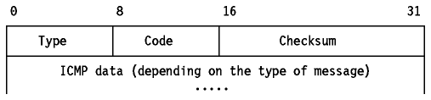
ICMP
Type Code description
0 0 echo reply (ping)
3 0 dest. network unreachable
3 1 dest host unreachable
3 2 dest protocol unreachable
3 3 dest port unreachable
3 6 dest network unknown
3 7 dest host unknown
Type Code description
4 0 source quench (congestion
control - not used)
8 0 echo request (ping)
9 0 route advertisement
10 0 router discovery
11 0 TTL expired
12 0 bad IP header

